Slide 1
Clustering-based Active Learning on Sensor Type Classification in Buildings Dezhi Hong, Hongning Wang, Kamin Whitehouse University of Virginia
Notes:
I’m here to talk about how we can use interesting learning techniques to figure out what a sensor measures just by looking at its name

Slide 2
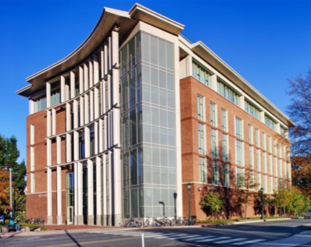
Costs of A Typical Commercial Building
~$800,000/year¹
Analytics tools save
10~13% of costs²
¹BOMA Kingsley Report 2010
²Schneider Electric Building Report 2013
Notes:
But before I get into that, lets look at some statistics about buildings
A typical office building consumes $ per year
Buildings are expensive to maintain, so new tools are coming that save energy and money

Slide 3
How an Analytics Engine Helps
86ºF
72ºF
Notes:
Suppose we have a bldg that sometimes overheats rooms
Often there are temp sensors in the bldg, so a tool can look at these measurements to figure out the problem

Slide 4
Challenge to Running an Engine
Mapping
Hot Air Temp RMI328
Room328
Hot Air Temperature
…...
RMI401 Space Temperature
Room 530
Mixed Air Temperature
Zone 2 MAT RMI530
Notes:
Can’t look at all bc different types of temp
can be hot water temp and cold air temp and so on
Technician looks cryptic name and figure out the mapping
sometimes has to visit
Takes time

Slide 5
SDH_SF1_R282_RMT
Zone1 Temp RMI328
RMI414 Space Temp
…
SODA1R300__ART
…...
Notes:
Manual labeling is intractable and unscalable

Slide 6
To create the mapping from sensor names in the buildings to the inputs of analytic engines with minimal manual effort
Problem Statement
Notes:
Particularly - type

Slide 7
Insight
-Same Type of Sensors have Similar Names
Zone1 Temp RMI328
RMI401 Space Temp
Also similar!
…
Label one from each!
Zone2 Temp RMI530
RMI414 Space Temp
…
Notes:
Cur solution is to look at each manually
However, there’s sim btw names we can use + where is that from
Group them by sim, and pick 1 from each
The rest will be easier and this reduces effort
over-optimistic bc cluster is not trivial
the philosophy is referred to as AL in the ML community

Slide 8
Active Learning
A new strategy
All about minimizing
manual labeling effort!
Selection Algorithm
Reinforce the
label to amplify
Notes:
Big pool
A selection algorithm to get the most rep for a human to label
Which is then used as the training set to learn a f and apply to the rest unlabeled pts

Slide 9
Active learning can reduce manual labeling effort for mapping the sensor names to their types in buildings
Hypothesis

Slide 10
Overview
Generate clusters on sensors based on similarity in names
Select a representative example x from a cluster c for manual labeling y
Label the most similar examples to x as y within cluster c
Notes:
Merge each to the title of each slide

Slide 11
Overview: Step I
-Generate Clusters
RMI414 Space Temp
RMI401 Space Temp
Notes:
These are sensor names from a building shown in some feature space (later)
Pts with similar names can be close, eg
So start from generate c

Slide 12
Overview: Step I
-Generate Clusters

Slide 13
Overview: Step I
-Generate Clusters
Classifier f

Slide 14
Overview: Step II
-Locate and Label a Representative
Classifier f
Notes:
should come from the most info c
and the most repre
apply f to c

Slide 15
Overview: Step II
-Locate and Label a Representative
Classifier f
Impurity
Size
Notes:
want to find a c with most impurity by H
Essentially, we are looking for area where the f and c disagree most
Also size

Slide 16
Overview: Step II
-Locate and Label a Representative
Notes:
How to pick repre

Slide 17
Overview: Step III
-Label Propagation and Sub-clustering
Notes:
next step, we want to further leverage the label
bc pts close to each other tend to have same label
propagate (will explain r)
(add human)

Slide 18
Overview: Step III
-Label Propagation and Sub-clustering
Classifier f
Notes:
with new labeled ex, re-train f
for this c, we know the res is not enough bc classification boundary goes inside the c
we need sub-cluster it

Slide 19
Overview: Step II
-Locate and Label a Representative
Classifier f
Impurity
Size
Notes:
apply f to unlabeled in all c
Use the same the metric to pick a cluster

Slide 20
Overview: Step II
-Locate and Label a Representative
Overview: Step III
-Label Propagation and Sub-clustering
Classifier f
Notes:
pick a repre for label
propagate
retrain

Slide 21
Overview: Step III
-Label Propagation and Sub-clustering
Classifier f
Notes:
sub-c

Slide 22
Name Feature
Zone Temp 2 RMI204
keep alphabets
Zone Tmp 1 RMI328
{zone, temp, rmi}
k-mers: ABCDEFG -> ABC, BCD, CDE… (k=3)
{zon, one, tmp, rmi }
frequency
count
{zon, one, tem, emp, rmi}
(1,1,0,0,1)
Notes:
for each sensor name, take out nums

Slide 23
Label Propagation Radius Estimation
Notes:
we propagated the label, but impossible to set a k
So how to estimate the radius

Slide 24
Label Propagation Radius Estimation
Intra-class pair
Inter-class pair

Slide 25
Label Propagation Radius Estimation
Notes:
intuitively, it should be the minimum inter-class d btw any pair
this is how we estimate

Slide 26
Label Propagation Correction
Notes:
And correction

Slide 27
Label Propagation Correction
Notes:
Happens before f training

Slide 28
Non-parametric Bayesian Clustering
Notes:
We use GMM, to avoid k then sue NPBC

Slide 29
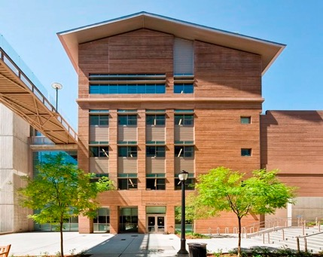
Evaluation Dataset
From 3 buildings on 2 campuses
2500+ streams
22 types
Building A
Building B
Building C
Notes:
we collect sensor names from 3 buildings
more than 2k of 22 types
we manually created all the GT

Slide 30
Baselines
Random
Least Margin (LM)
Pre-clustering (PC): representativeness and uncertainty
Hierarchical Clustering (HC): impurity of clusters and size
Notes:
each has a different selection strategy

Slide 31
Labeling Effort vs. Accuracy
10-fold cross validation (9 for training, 1 for testing)
Run 130 iterations for each algorithm
Repeat 10 times for each building
The average is reported
We use a linear SVM

Slide 32
Labeling Effort vs. Accuracy
1/3 less
Classification Accuracy
OUR
Building A
Notes:
A bunch of curves to give you sense how we perform against them
Only look at our and red
Given a certain acc, we reduce the labeling by at least 30%
what that number means for real

Slide 33
Effect of Clustering and Label Propagation on Accuracy
Clustering
(NO Clustering)
Label Propagation
(NO Propagation)
Notes:
We have two components in the algorithm
Disable either or both to test the effect

Slide 34
Effect of Clustering on Accuracy
Classification Accuracy
Original
Building A
Notes:
LM+P is bad on A because loose estimation of r
Only catch up later with enough exs

Slide 35
Effect of Label Propagation on Accuracy
Classification Accuracy
Original
Building A
Notes:
Adding clustering alone is no better than LM
After adding p it gets better because more ex
We attribute

Slide 36
A Search
Find the sensors in the same room
O: Occupancy T: Temperature H: Humidity C: CO2
Only one pattern got discovered
Notes:
Backup

Slide 37
Conclusion
Leveraged the patterns in point names
Developed a new active learning algorithm
Evaluated on a real dataset covering three buildings
Our approach requires less labeled examples and enable potential useful applications
Notes:
New AL includes a sel and prop

Slide 38
Thanks!
Questions?

